Slide 1
Counting Sort

Slide 2
Counting Sort
01
It is Stable sort:
preserves the original order of input set
02
03
Counting sort is a sorting technique that is based on the keys between specific ranges.
Perform sorting by non-comparing elements.
It performs sorting by counting objects having distinct key values like hashing.
Counting sort is effective when range is not greater than number of objects to be sorted.
It can be used to sort the negative input values.

Slide 3
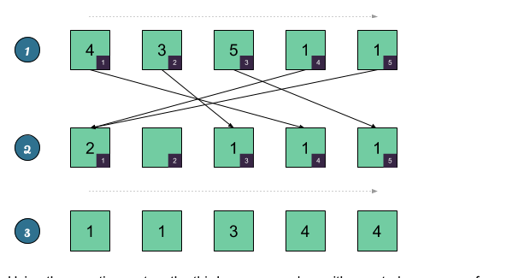
Real Life Application
01
Counting Sort
02
03
Frequently used as a subroutine in other sorting algorithms

Slide 4
Counting Sort - Algorithm
01
Pseudocode
02
countingSort(array, size)
max = find largest element in array
Create Count Array with size maximum +1
initialize count array with all zeros
for j = 0 to N
find the total count of each unique element and
store the count at jth index in count array
for i = 1 to max
find the cumulative sum and store it in count array itself
for j = N to 1
restore the elements to array
decrease count of each element restored by 1
End CountingSort
03

Slide 5
Counting Sort - Working
01
It is Stable sort:
preserves the original order of input set
02
Now, let's see the working of the counting sort Algorithm.
To understand the working of the counting sort algorithm,
let's take an unsorted array. It will be easier to understand the counting sort via an example.
Let the elements of array are –
.
03
2 | 1 | 2 | 3 | 1 | 2 | 4

Slide 6
Working Cnti…
Step1. Find the maximum element from the given array. Let 4 will be the maximum element .
Step2. initialize array which will be used to store the count of the elements in the given array array.
4 |  | 2 | 1 | 2 | 3 | 1 | 2 | 4
Index
0 | 1 | 2 | 3 | 4
0 | 0 | 0 | 0 | 0
count array

Slide 7
Given Array
2 | 1 | 2 | 3 | 1 | 2 | 4
Step3 . Now, we have to store the count of each array element at their corresponding index in the count array.
Step4. Now Store the cumulative sum of the Count array element .It will help to place the element at correct sorted position
.
Index
0 | 1 | 2 | 3 | 4
0 | 2 | 3 | 1 | 1
count array
Index
0 | 1 | 2 | 3 | 4
0 | 2 | 5 | 6 | 7
Sorted Position=6
Sorted Position=7
Sorted Position=2
Sorted Position=5
N=7
1 | 2 | 3 | 4 | 5 | 6 | 7
1 | 1 | 2 | 2 | 2 | 3 | 4
Sorted array

Slide 8
Merits & Demerits
01
Counting Sort
02
03
works when the range of potential items in the input is known ahead of time
Space cost: If the range of potential values is big, then counting sort requires a lot of space
Stable Sort
it accomplishes sorting in linear time,

Slide 9
Complexity Analysis
01
Counting Sort
02
03
k is the range of the keys
 | Worst Time | Average Time | Best Time
Time Complexity | O(n+k) | O(n+k) | O(n+k)
Space Complexity | O(max) | O(max) | O(max)

Slide 10
Thank You

